Slide 1
Chapter 33 – Macromedia® Flash™ 4: Building Interactive Animations
Outline
33.1 Introduction
33.2 Learning Flash with Hands-on Examples
33.2.1 Changing the Appearance of the Stage
33.2.2 Creating a Shape with the Oval Tool
33.2.3 Adding Text to a Button
33.2.4 Converting a Shape into a Symbol
33.2.5 Adding Keyframes
33.2.6 Editing Button Symbols
33.2.7 Using the Paint Bucket Tool
33.2.8 Using Test Movie to Verify Changes
33.2.9 Adding Layers to a Movie
33.2.10 Using Tweening to Animate Text
33.2.11 Adding a Text Field
33.2.12 Adding ActionScripting

Slide 2
Chapter 33 – Macromedia® Flash™ 4: Building Interactive Animations
Outline
33.3 Creating a Projector(.exe) File Using Publish
33.4 Manually Embedding a Flash Movie in a Web page
33.5 Using Flash for Special Effects
33.5.1 Importing and Manipulating Bitmaps
33.5.2 Using Masking to Create an Advertisement Banner
33.5.3 Adding Online Help to Your Forms
33.5.4 Adding Sound
33.5.5 Creating a Web-Site Introduction
33.6 Creating a Store Front
33.7 Using Loops and Functions
33.8 ActionScripts

Slide 3
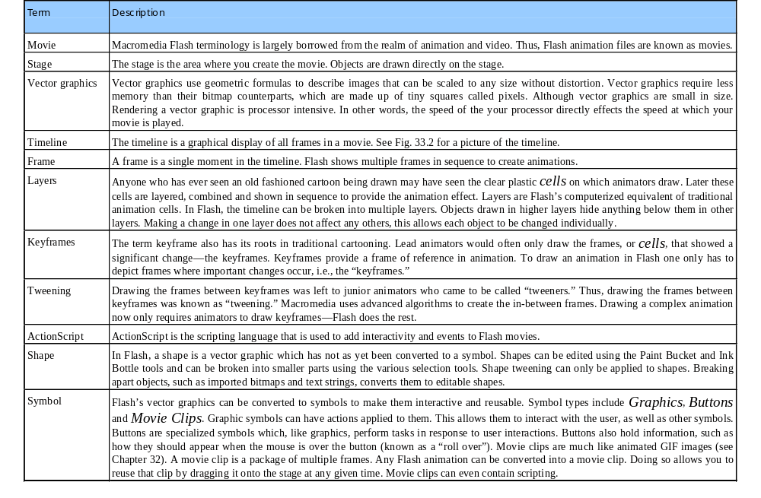
Fig 33.1 (part 1)

Slide 4
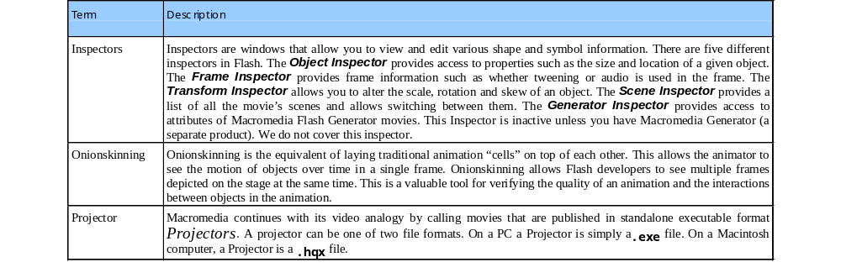
Fig 33.1 (part 2)

Slide 5
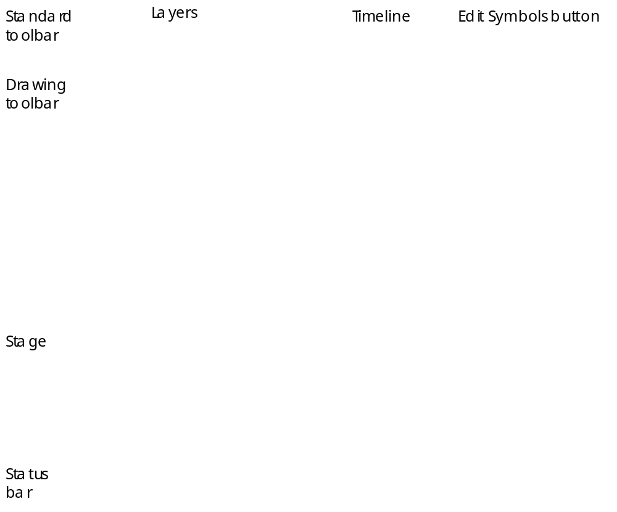
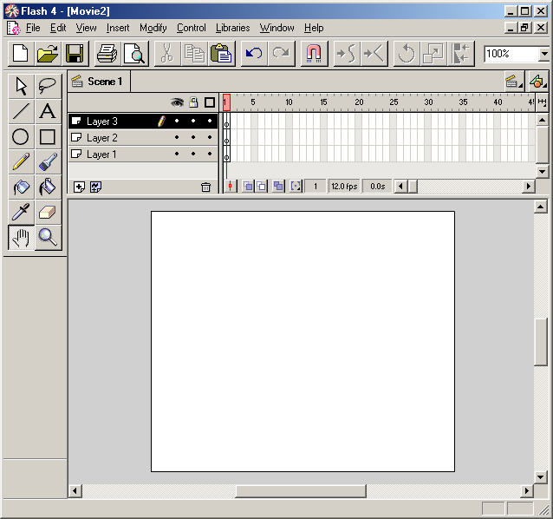
Fig 33.2
Courtesy of Macromedia, Inc.

Slide 6

Fig 33.3
Arrow tool
Lasso tool
Line tool
Text tool
Oval tool
Rectangle tool
Pencil tool
Brush tool
Ink bottle tool
Paint bucket tool
Dropper tool
Eraser tool
Hand tool
Zoom tool
    Courtesy of Macromedia, Inc.

Slide 7
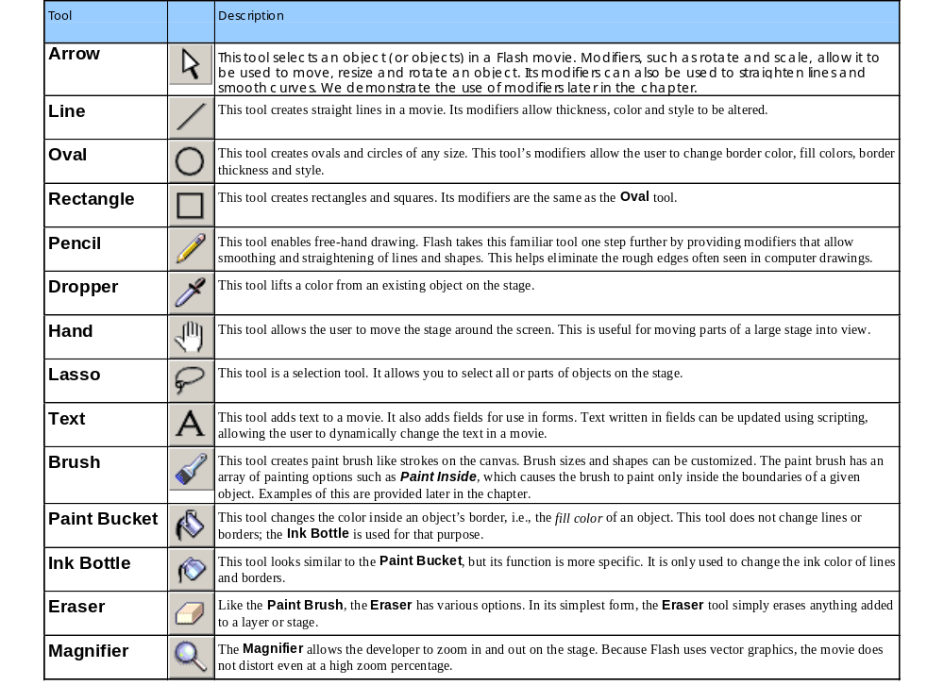
Fig 33.4

Slide 8
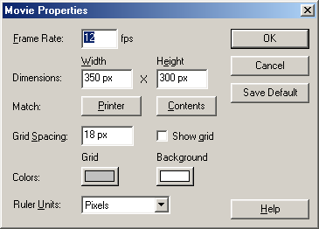
Fig 33.5
    Courtesy of Macromedia, Inc.

Slide 9

Fig 33.6
Zoom in
Zoom out
    Courtesy of Macromedia, Inc.

Slide 10

Fig 33.7
Line color
Stroke color focus
Line thickness
Line style
Fill color
    Courtesy of Macromedia, Inc.

Slide 11
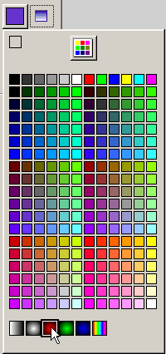
Fig 33.8
Color swatches
Gradient swatches
    Courtesy of Macromedia, Inc.

Slide 12

Fig 33.9
Font
Font size
Font color
Bold
Italic
Alignment
Paragraph
Text field
    Courtesy of Macromedia, Inc.

Slide 13

Fig 33.10
    Courtesy of Macromedia, Inc.

Slide 14
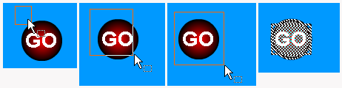
Fig 33.11
    Courtesy of Macromedia, Inc.

Slide 15
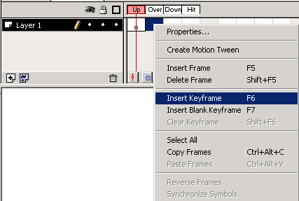
Fig 33.12
    Courtesy of Macromedia, Inc.

Slide 16

Fig 33.13
Fill color
Gap size
Lock fill
Transform fill
    Courtesy of Macromedia, Inc.

Slide 17


Fig 33.14
    Courtesy of Macromedia, Inc.

Slide 18
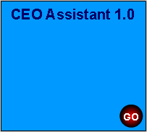
Fig 33.15
    Courtesy of Macromedia, Inc.

Slide 19

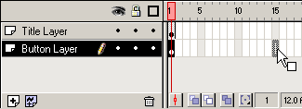
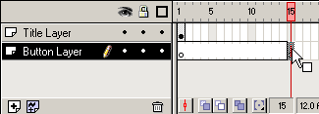
Fig 33.16
    Courtesy of Macromedia, Inc.

Slide 20
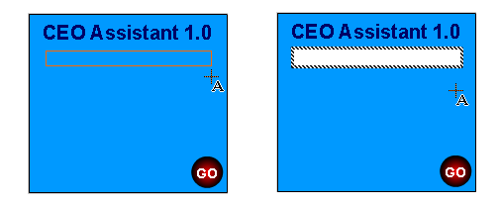
Fig 33.17
    Courtesy of Macromedia, Inc.

Slide 21
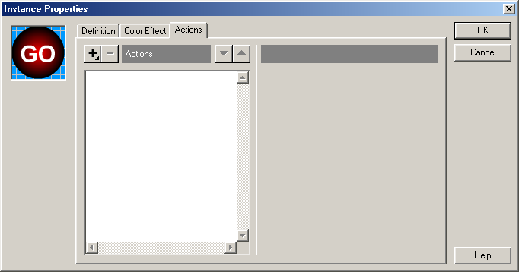
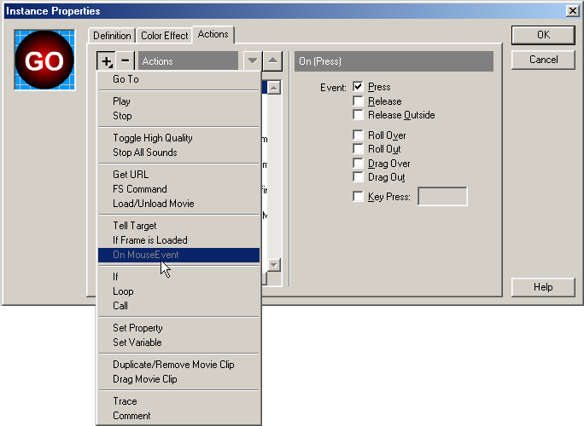
Fig 33.18
Add action
Remove action
OnMouseEvent
    Courtesy of Macromedia, Inc.

Slide 22
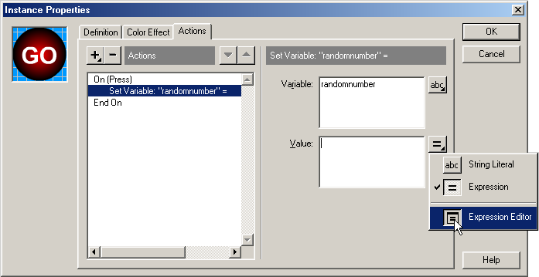
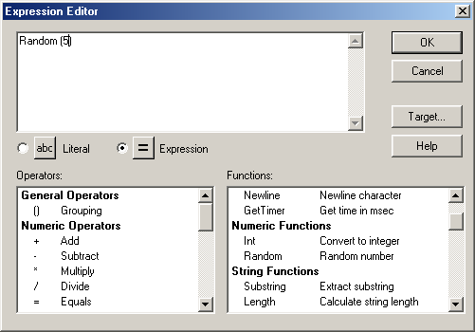
Fig 33.19
    Courtesy of Macromedia, Inc.

Slide 23
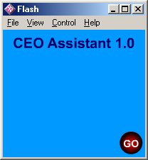
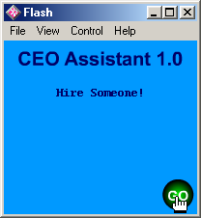
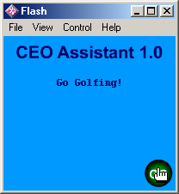
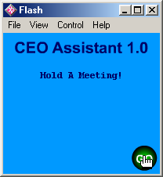

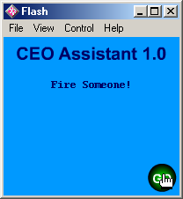
Fig 33.20
    Courtesy of Macromedia, Inc.

Slide 24
1 <HTML>
2
3 <!-- Fig. 33.21: Embedding a Flash Movie into a Web site -->
4 <!-- ceoassist.html -->
5
6 <!DOCTYPE HTML PUBLIC "-//W3C//DTD HTML 4.0 Transitional//EN">
7 <HTML>
8
9 <HEAD>
10 <TITLE>
11 Adding Flash to your Web site
12 </TITLE>
13 </HEAD>
14
15 <BODY>
16
17 <!-- The following OBJECT tag tells the Microsoft -->
18 <!-- Internet Explorer browser to play the Flash Movie -->
19 <!-- and where to find the Flash Player plug-in if it -->
20 <!-- is not installed. -->
21
22 <OBJECT CLASSID = "clsid:D27CDB6E-AE6D-11cf-96B8-444553540000"
23 CODEBASE =
24 "http://download.macromedia.com/pub/shockwave/cabs
25 /flash/swflash.cab#version=4,0,2,0">
26 <PARAM NAME = "Movie" VALUE = "ceoassist.swf">
27
28 <!-- The following EMBED tag tells the Netscape Navigator -->
29 <!-- browser to play the Flash Movie and where to find the -->
30 <!-- Flash Player plug-in if it is not installed. -->
31
32 <EMBED SRC = "ceoassist.swf" PLUG-INSPAGE =
33 "http://www.macromedia.com/shockwave/download

Slide 25
34 /index.cgi?P1_Prod_Version=ShockwaveFlash">
35 </EMBED>
36
37 <NOEMBED>
38 This Web site contains the CEO Assistant 1.0 Flash movie.
39 You must have the Flash PLayer plug-in to see the Flash movie.
40 </NOEMBED>
41
42 </OBJECT>
43
44 </BODY>
45 </HTML>

Slide 26
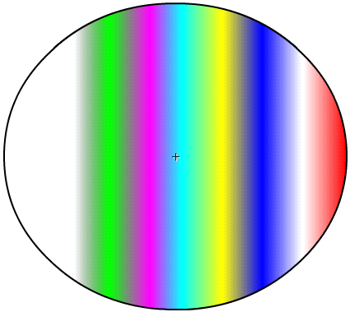
Fig 33.22
    Courtesy of Macromedia, Inc.

Slide 27
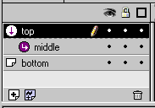
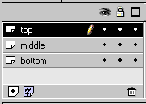
Fig 33.23
    Courtesy of Macromedia, Inc.

Slide 28

Fig 33.24
    Courtesy of Macromedia, Inc.

Slide 29

Fig 33.25
    Courtesy of Macromedia, Inc.

Slide 30

Fig 33.26
    Courtesy of Macromedia, Inc.

Slide 31

Fig 33.27
    Courtesy of Macromedia, Inc.

Slide 32



Fig 33.28
Frame 5
Frame 10
Frame 1

Slide 33
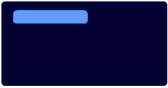
Fig 33.29
    Courtesy of Macromedia, Inc.

Slide 34
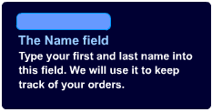
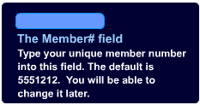
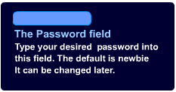
Fig 33.30
    Courtesy of Macromedia, Inc.

Slide 35
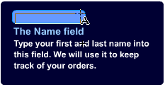
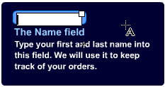
Fig 33.31
    Courtesy of Macromedia, Inc.

Slide 36

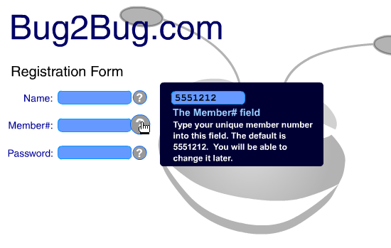
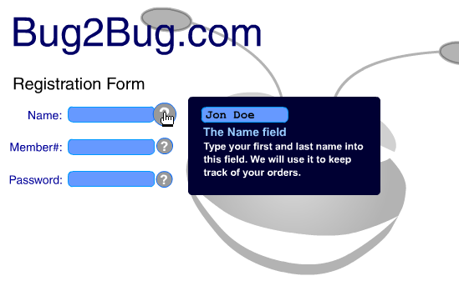
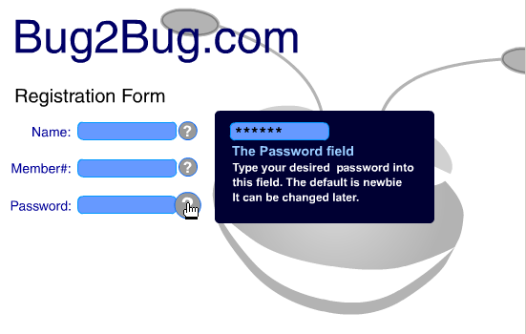
Fig 33.32
    Courtesy of Macromedia, Inc.

Slide 37
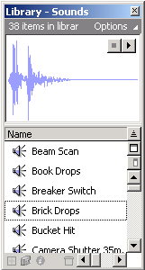
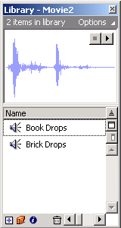
Fig 33.33
    Courtesy of Macromedia, Inc.

Slide 38
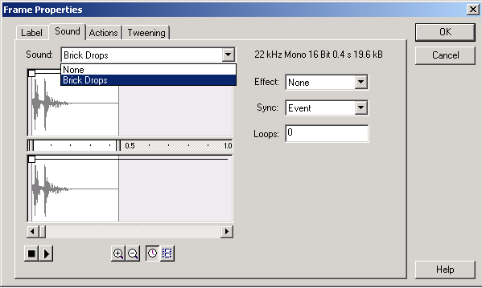
Fig 33.34
    Courtesy of Macromedia, Inc.

Slide 39
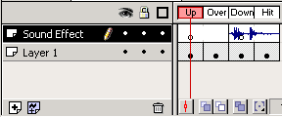
Fig 33.35
Sound Clip
    Courtesy of Macromedia, Inc.

Slide 40
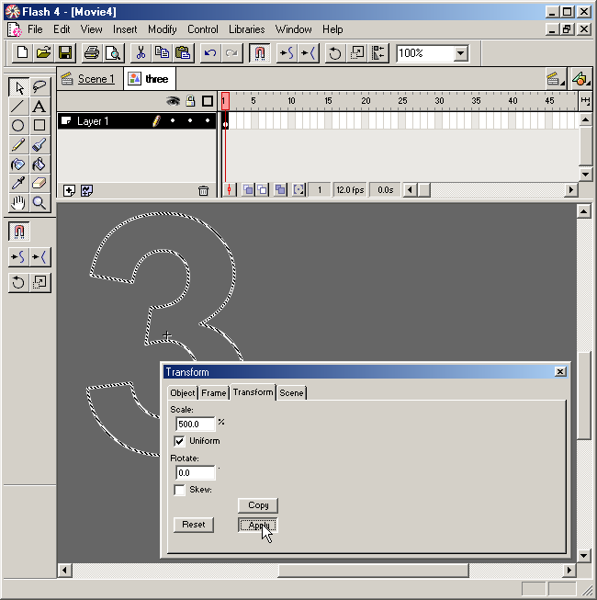
Fig 33.36
    Courtesy of Macromedia, Inc.

Slide 41
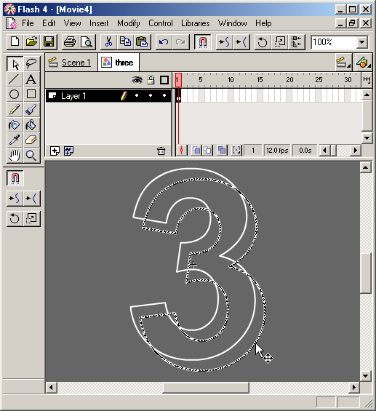
Fig 33.37
    Courtesy of Macromedia, Inc.

Slide 42
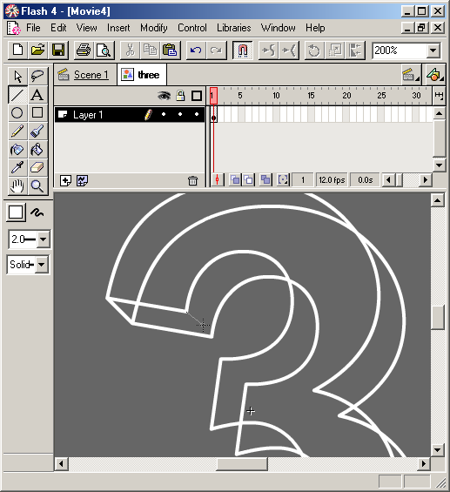
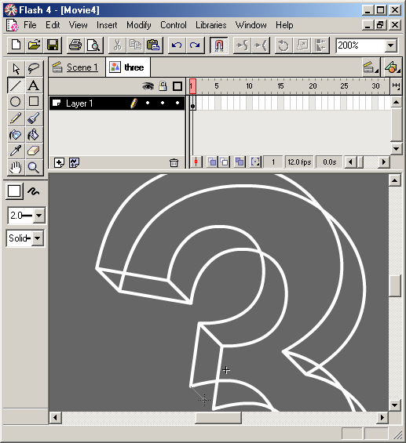
Fig 33.38
    Courtesy of Macromedia, Inc.

Slide 43

Fig 33.39
    Courtesy of Macromedia, Inc.

Slide 44
Fig 33.40
    Courtesy of Macromedia, Inc.

Slide 45
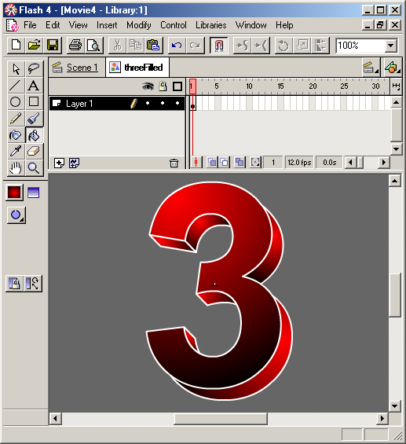
Fig 33.41
    Courtesy of Macromedia, Inc.

Slide 46
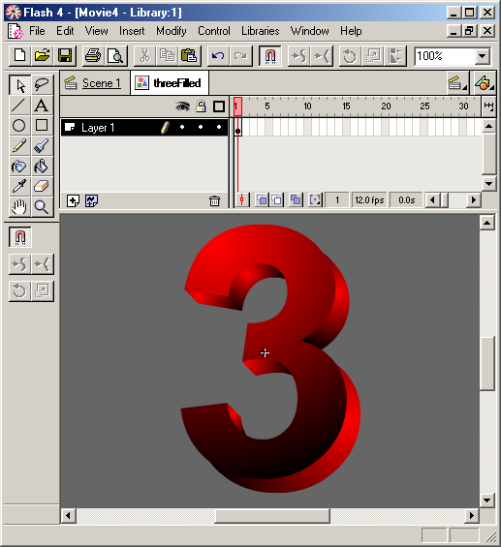
Fig 33.42
    Courtesy of Macromedia, Inc.

Slide 47
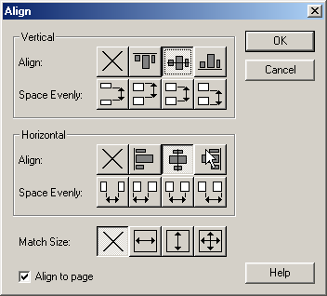
Fig 33.43
    Courtesy of Macromedia, Inc.

Slide 48

Fig 33.44
    Courtesy of Macromedia, Inc.

Slide 49
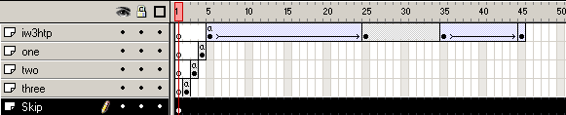
Fig 33.45
    Courtesy of Macromedia, Inc.

Slide 50
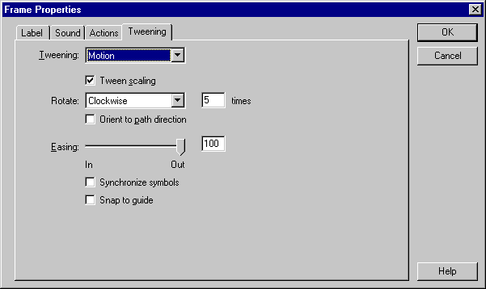
Fig 33.46
    Courtesy of Macromedia, Inc.

Slide 51
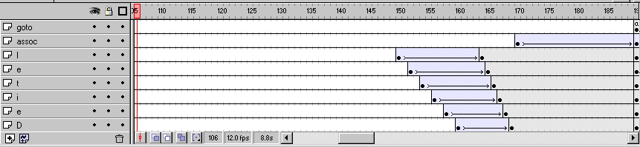
Fig 33.47
    Courtesy of Macromedia, Inc.

Slide 52

Fig 33.48
    Courtesy of Macromedia, Inc.

Slide 53
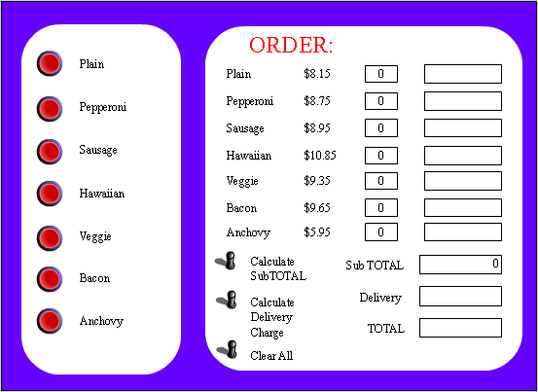
Fig 33.49
Text
Pizza quantities
Pizza totals
    Courtesy of Macromedia, Inc.
Buttons

Slide 54
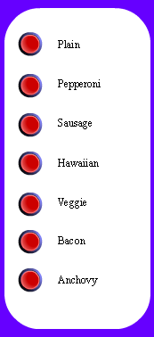

Fig 33.50
    Courtesy of Macromedia, Inc.

Slide 55

Fig 33.51
    Courtesy of Macromedia, Inc.

Slide 56

Fig 33.52
    Courtesy of Macromedia, Inc.

Slide 57
1 Comment: Initialize variables. Set all value types to
2 Comment: expression in the actions window.
3 Set Variable: "count" = 0
4 Set Variable: "randomX" = 0
5 Set Variable: "randomY" = 0
6
7 Comment: This variable keeps track of all movies created
8 Comment: while the movie plays.
9 Set Variable: "total" = total+createNumber
10
11 Comment: This number of repetitions this while loop
12 Comment: completes is decided by user input.
13 Loop While (count < createNumber)
14
15 Comment: Get random variables for location of each
16 Comment: movie clip.
17 Set Variable: "randomX" = Random(450) + 100
18 Set Variable: "randomY" = Random(300)
19
20 Comment: This action creates new movie clips based
21 Comment: on the value of count.
22 Duplicate Movie Clip ( "/flower", "flower" &count, count )
23
24 Comment: The following code sets the attributes for each
25 Comment: movie clip that is created.
26 Set Property ( "/flower" & count, X Position ) = randomX
27 Set Property ( "/flower" & count, Y Position ) = randomY
28 Set Property ( "/flower" & count, Alpha ) = Random(50) + 50
29 Set Property ( "/flower" & count, X Scale ) = Random(200) + 5
30 Set Property ( "/flower" & count, Y Scale ) = Random(200) + 50
31
32 Comment: Increment count to prevent an infinite loop
33 Set Variable: "count" = count + 1
34 End Loop

Slide 58
1 Set Variable: "count" = 0
2
3 Comment: The total variable is used to be sure that all of the movie
4 Comment: clips are removed.
5 Loop While ( count < total )
6
7 Comment: This action removes the movie clips.
8 Remove Movie Clip ( "flower" & count )
9 Set Variable: "count" = count + 1
10 End Loop

Slide 59

Fig 33.55
    Courtesy of Macromedia, Inc.

Slide 60

Fig 33.56

